Slide 1
Indian Ceramic Tile
Industry & Sanitaryware

Slide 2
Good afternoon to all dignitaries, fellow industry colleagues, and guests.
It’s a privileged moment for me to be Infront of you and share India’s success story of Tiles & Sanitary Ware industry which created immense opportunities for World’s market to associate with India and consider India as a growth partner in their business.
The Indian Ceramic Industry came into existence about a century ago and has matured over time to form an industrial base. Over the years, the industry has been modernizing through new innovations and product profile, quality and design to emerge as a modern World class industry ready to take on global competition
Tiles industry is classified in 3 verticals :
Ceramic Wall (40%)
Unglazed Polished Vitrified Tiles (PVT) – also known as Porcelain Tiles / Technical Tiles (35%)
Glazed Vitrified Tiles (GVT) – (25%)
The major change in tile industry took over when Vitrified Tiles were introduced in both the formats viz PVT and GVT.
Recently, 4 years back Indian manufacturers started manufacturing World’s biggest Porcelain Slabs in the size 1600x3200mm. This category has potential to substitute natural Granite and Marbles. These new entrants products are set to be tiles of future.

Slide 3
Indian Tile Industry enjoys the unique distinction of being highly indigenous with an abundance of raw material, technical skills, availability of natural gas, continuous power supply, availability of ports.
Today Indian Tile Industry has become global player and earns foreign exchange for the nation with “Make In India” approach and urge, India today is World’s 2nd largest manufacturer of tiles.
Today India has more than 1000 manufacturers including all the formats,
Wall : 550 plants
Floor : 150 plants
Vitrified : 300 plants (PVT & GVT)
Slabs : 25 plants

Slide 4
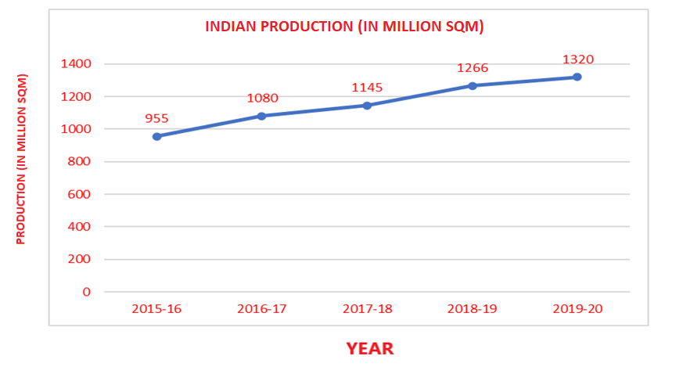
With 1025 manufacturers of tiles in India our production capacity is 1320 million SQM. Recently, India has overtaken Spain.

Slide 5
India’s Export -
India’s export is almost doubled in the span of just 4 years from 228 million sq mtr to 437 million sq mtr which is almost 33% of India’s production . Inspite of pandemic period India’s export during the period grew by 21% from 360 million sq mtr to 437 million sq mtr.
With export of 437 Million SQM India’s contribution to world’s export is 15.8%.
Country | 2017 (Mill.Sq.M) | 2018 (Mill .Sq.M) | 2019 (Mill .Sq.M | 2020 (Mill .Sq.M | %in 2020 on national production
INDIA | 228 | 274 | 360 | 437 | 33.1%

Slide 6
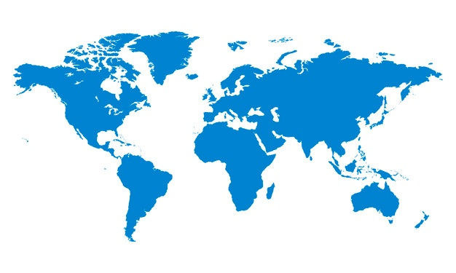
Worldwide Export
India exports to more than 125 countries and top 10 countries are –
Saudi Arabia
United States
Mexico
Kuwait
United Arab Emirates
Iraq
Oman
Indonesia
United Kingdom
Poland
I am happy to say that Kuwait is the 4th largest importer of Indian Tiles with business of 75 Million US Dollar. Share of Kuwait market is 5% of total India’s tile export.

Slide 7
INDIA AS “THE” DESTINATION FOR Renowned WORLD Brands
Today India has become hub for many leading brands of the World who outsource from India. This speaks volumes about the quality of our products, service capability apart from ability and capability of Indian manufacturers. Some of the leading World’s brands are :
Caesarstone
Castel
RAK
Lamosa
Daltile USA
Dongpeng
Monalisa
SCG
Portinari
Portobello & many More World’s leading brands.

Slide 8
India adheres to all the International standards and EN standards of being a

Slide 9
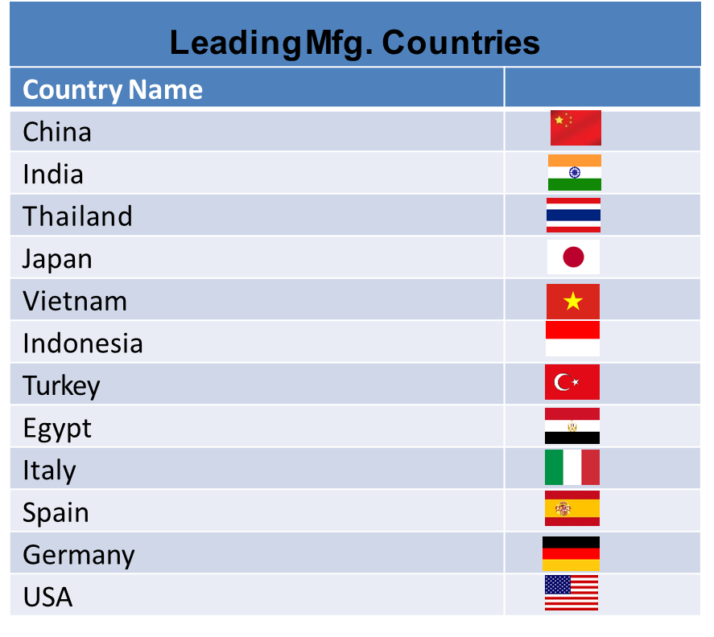
SANITARY WARE
With respect to Sanitary Ware products India has capacity of 40 Million Pcs per year with 150+ plants, India is the 2nd largest producer of Sanitary Ware after China
$ 12 billion market world over for Sanitary Ware
India is the 2nd largest Sanitary Ware producer after China
India presently produces around 10% of the total global output in which Gujarat Province accounts for 70% of the total output

Slide 10
SANITARY WARE
India is evolving as Sanitary Ware industry hub and many global sanitary ware brands have put up their plants in India and service Indian demand and exports to the World. These brands are :
Kohler
Roca
Duravit
RAK
TOTO
Lixil Group (American Standard / Grohe)
Many Indian manufacturers are contributing in the growth of Sanitary Ware industry such as :
Parryware
HSIL
Cera
Jaquar
Somany
Kajaria (Kerovit)
Simpolo
Indian Sanitary Ware market is valued approx. 675 Million US Dollar

Slide 11
INDIA’S REFRACTORY INDUSTRY :
Annual turnover of INR10000 Crores
Yearly growth of 7 - 8%
Indian Refractory makers produce all range of refractories from low end alumina bricks to high end flow control systems
70% of the products are shaped products and the balance 30% are unshaped.

Slide 12
Excellent mineral raw material quality with consistency in availability
Highly skilled labour available in India
India has 12 major ports. All ports are well connected to road and rail network
India keeps up with modernisation and satisfies aspirations of millennial consumers
Competitive in price and consistency in availability
Better freight from India
Adaptability to International culture, language, new technology, emerging trends
Focus on end consumers and offers best after sales service
Stability of Govt Policies/Corporate philosophy
Emerging as the best choice vis a vis China especially after Covid 19 situation
India Ceramic and Sanitaryware manufacturers are having latest technology and latest design for their customers
Government focus on Infrastructure development expected to result in major driving factor in the growth of Indian economy.
WHY INDIA ?

Slide 13
With this favourable environment in India and with ability, capability, and vision of Indian entrepreneurs and promoters to globalize this industry – India is THE destination for World markets for tiles and sanitary ware requirements.
India offers value for money – India offers quality better than Italy and Spain and rates competitive to China.
I am sure guest will find India as the land of opportunities.

Slide 14
Thank You
&
Jai Hind

